Slide 1

Introduction to
Graphing in Excel
go.ncsu.edu/excelgraphing
Mike Nutt & Karen Ciccone

Slide 2
Goals
This session will provide:
Where to get help from the Libraries
An introduction to basic chart types available in Excel
How to improve Excel defaults
Hands-on practice navigating design menus
Resources for further learning about Excel

Slide 3
Slides and activity guide
go.ncsu.edu/excelgraphing

Slide 4







Data & Visualization Services
Natalia Lopez
Mia Partlow
Walt Gurley
Jeff
Essic
Karen Ciccone
Mike
Nutt
Ashley Evans Bandy
Finding & acquiring datasets
GIS & mapping
Data cleaning & manipulation
Data visualization
Qualitative analysis (text
mining, data harvesting)
Quantitative analysis (R, SAS, Python)
Questions?: go.ncsu.edu/dvs-request
Workshops: go.ncsu.edu/workshops

Slide 5

Questions?
Talk to our Data Science Consultants!
go.ncsu.edu/
dataspace

Slide 6
Data Visualization Process
getting data
getting to know the data
setting goals, asking questions
determining if a visualization is needed
deciding what to visualize
cleaning
visualizing
designing (potentially re-visualizing it with a different tool)
exporting/embedding

Slide 7
Excel versions
Tutorial directions written using Excel 2016
What are people using?
Mac
2015 Excel 15.0 (part of Office 2016) is closer to Windows interface (e.g., ribbon)

Slide 8
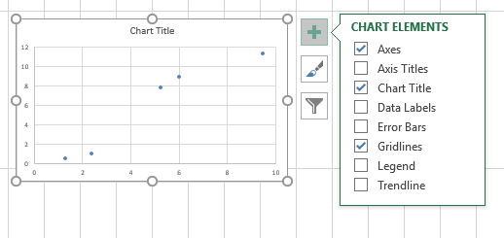
Windows

Slide 9
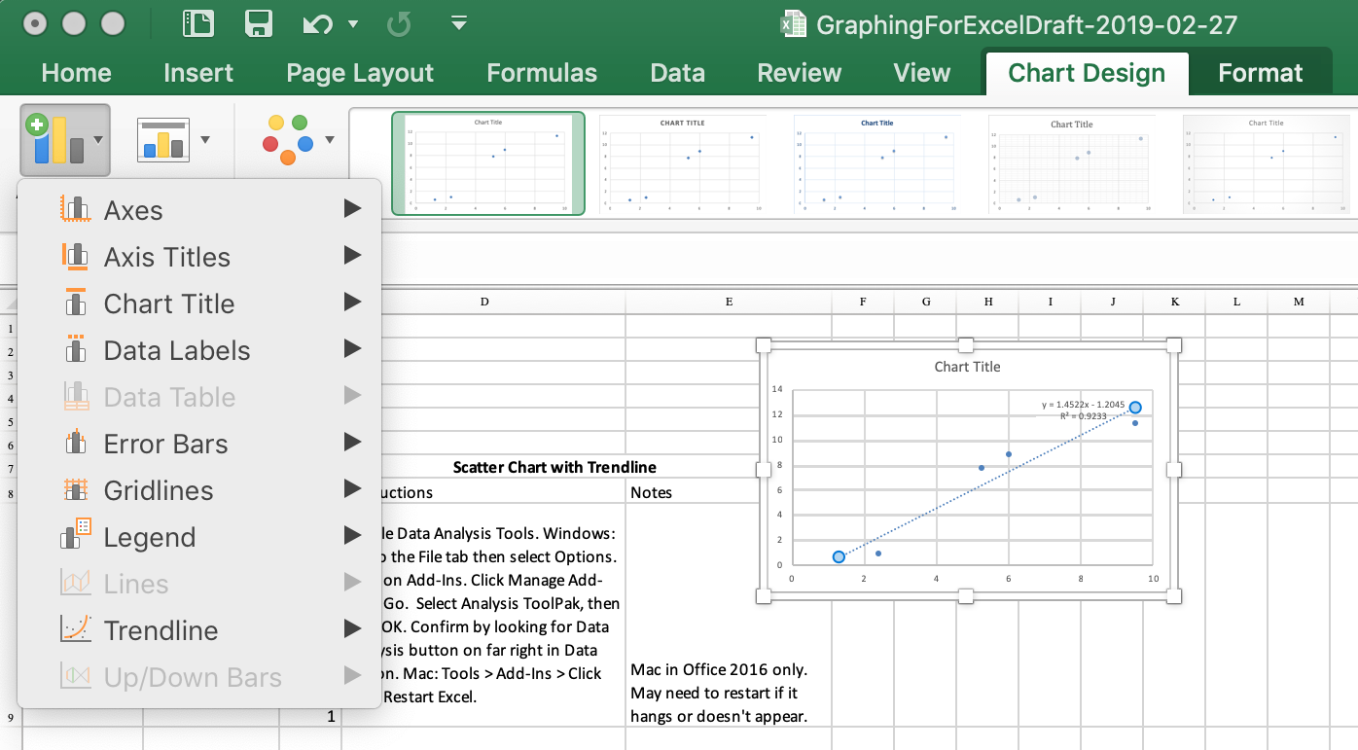
Mac

Slide 10
GraphingInExcelActivities_2019-10-16.xlsx

Slide 11
Duke Libraries Recipe Book
https://guides.library.duke.edu/excel

Slide 12
go.ncsu.edu/libeval

